Slide 1
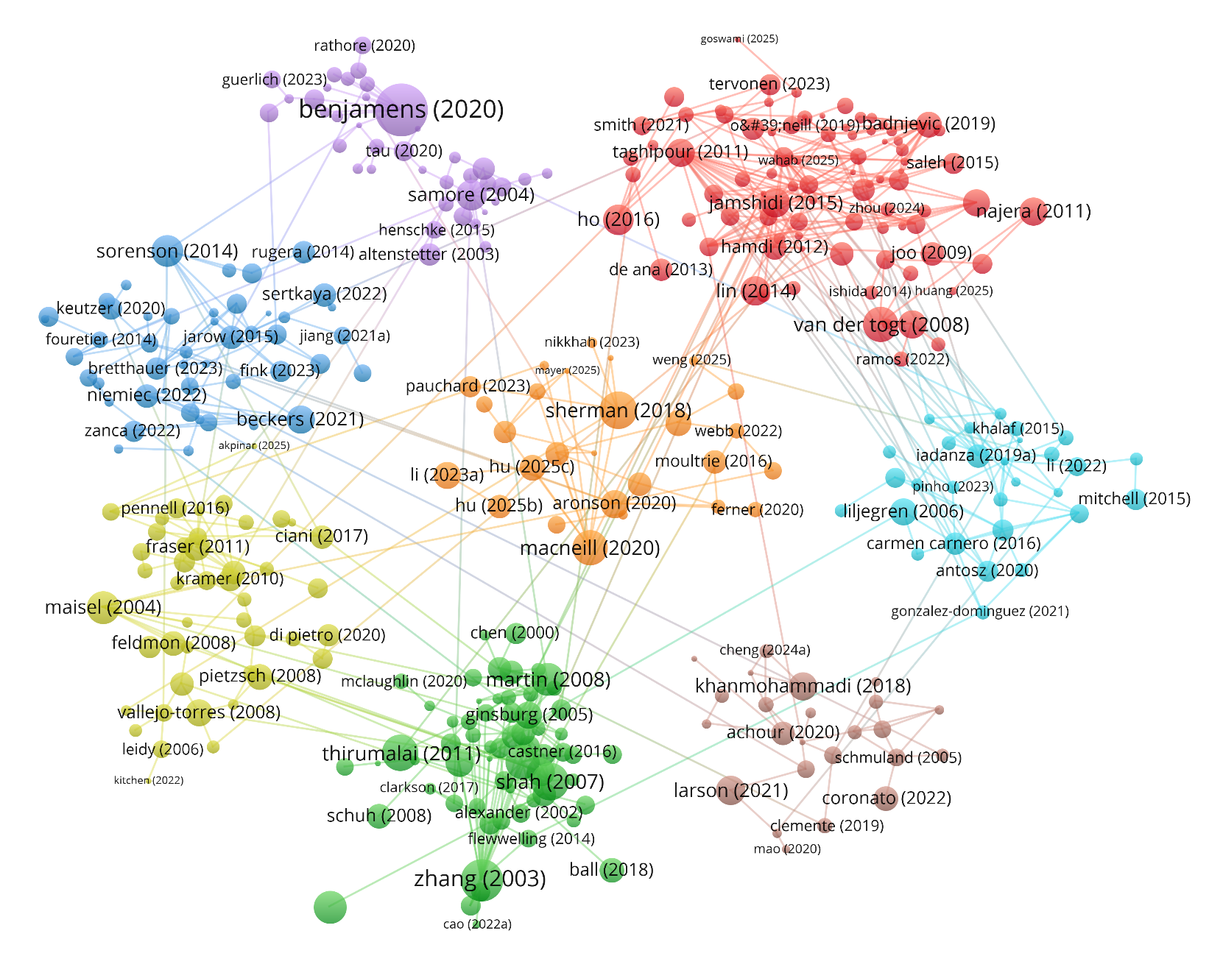
#1 宏观现状与监管
#5 技术风险管理
Benjamens (2020): The state of artificial intelligence-based FDA-approved medical devices and algorithms: an online database 基于人工智能的美国FDA获批医疗器械与算法现状：一个在线数据库
Samore (2004): Surveillance of Medical Device–Related Hazards and Adverse Events in Hospitalized Patients 住院患者医疗器械危害与不良事件监测研究
Van der togt (2003): Electromagnetic Interference From Radio Frequency Identification Inducing Potentially Hazardous Incidents in Critical Care Medical Equipment 射频识别的电磁干扰在重症监护医疗设备中诱发潜在危险事件
Lin (2014): Human reliability assessment for medical devices based on failure mode and effects analysis and fuzzy linguistic theory 基于失效模式与影响分析及模糊语言理论的医疗器械人因可靠性评估
#2 法规与政策比较
#6 维护管理与评估
Sorenson (2014): Improving Medical Device Regulation: The United States and Europe in Perspective 改进医疗器械监管：美国和欧洲的视角
Beckers (2021): The EU medical device regulation: Implications for artificial intelligence-based medical device software in medical physics 欧盟医疗器械法规：对医学物理学中基于人工智能的医疗器械软件的影响
Liljegren (2006): Usability in a medical technology context assessment of methods for usability evaluation of medical equipment医疗技术背景下可用性：医疗器械可用性评估方法评述
Iadanza (2019a): Evidence-based medical equipment management: a convenient implementation循证医学设备管理：一种便捷的实施方法
#3 卫生经济学
#7 全生命周期与产业
Maisel (2004): Medical Device Regulation: An Introduction for the Practicing Physician 医疗器械监管：执业医师入门
Valleji-torres (2008): Integrating health economics modeling in the product development cycle of medical devices: A Bayesian approach在医疗器械产品开发周期中整合卫生经济学建模：一种贝叶斯方法
Sherman (2018): Life Cycle Assessment and Costing Methods for Device Procurement: Comparing Reusable and Single-Use Disposable Laryngoscopes 设备采购的生命周期评估与成本核算方法：可重复使用与一次性喉镜的比较
Macneil (2020): Transforming The Medical Device Industry: Road Map To A Circular Economy 转型医疗设备产业：通向循环经济的路线图
#4 人因工程
#8 应急准备与监管
Zhang (2003): Using usability heuristics to evaluate patient safety of medical devices运用可用性启发法评估医疗器械的患者安全性
Shah (2007): Benefits of and barriers to involving users in medical device technology development and evaluation用户参与医疗器械技术开发与评估的益处和障碍
Khanmohammadi (2018): A system dynamics approach to the seismic resilience enhancement of hospitals 增强医院抗震韧性的系统动力学方法
Larson (2021): Regulatory frameworks for development and evaluation of artificial intelligence-based diagnostic imaging algorithms: summary and recommendations 基于人工智能的诊断成像算法开发与评估的监管框架

